Slide 1
Agentic AI for Personalized Course Pathways
IBM SKILLSBUILD AI & CLOUD INTERNSHIP PROJECT
Presented By:
Student name : Ishita Singh
College Name & Department : University of Lucknow, BCA

Slide 2
OUTLINE
Problem Statement
Technology used
Wow factor
End users
Result
Conclusion
Git-hub Link
Future scope
IBM Certifications

Slide 3
Problem Statement
Students often struggle to identify the right learning path that aligns with their interests and long-term goals due to the overwhelming number of online courses and a lack of personalized guidance.
Proposed Solution: LearnMate is an AI-powered Agentic Coach that interacts with students, helps them explore their interests (e.g., Web Development, Cybersecurity, UI/UX), assesses their current skill level, and dynamically builds a personalized course roadmap, adapting over time based on the learner’s progress and preferences.

Slide 4
Technology used
IBM Cloud Lite Services – For deployment and testing within a cloud environment
Model Parameter Tuning – For customizing AI behavior for tone, creativity, and relevance
LangChain Framework – To manage agent logic, memory, and tool use
ReAct Architecture – To enable reasoning + action flow for adaptive conversations
IBM Granite Model – For natural language understanding and reasoning

Slide 5
IBM cloud services used
IBM Watsonx.ai Studio - To build, configure, and deploy the Agentic AI using foundation models
IBM Watsonx.ai Runtime - For executing and managing the deployed agent’s interactions
IBM Watsonx.ai Agent Lab - For designing agent instructions, abilities, and conversation flows
IBM Granite Foundation Model - Used as the core LLM to enable intelligent, context-aware responses

Slide 6
Wow factors
Domain-Focused & Professional: Responds only to queries related to technology, academics, learning paths, or career advice, avoiding unrelated topics like entertainment or politics for a focused learning experience.
Smart & Personalized Learning Paths: Assesses user interests and skill level to build customized course roadmaps that adapt over time as the user learns and progresses.
Inquisitive & Interactive Approach: Learns through conversation by asking questions at each step, ensuring the roadmap and advice align with the user’s choices, preferences, and goals.
Context-Aware Memory: Remembers the user’s selected domain (e.g., Cybersecurity, Web Dev) to provide consistent, tailored guidance throughout the conversation.
Resource Recommender & Interview Support: Suggests top free & paid learning resources, clears career confusion, and helps with interview preparation based on the user's chosen field.

Slide 7
End users
Students & Freshers
Self-learners & Upskillers
Aspiring Technologists
Educational Institutions & EdTech Platforms

Slide 8
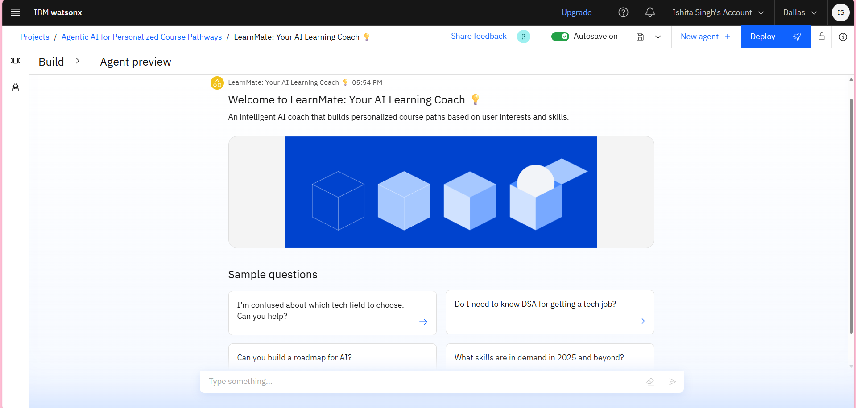
Results

Slide 9
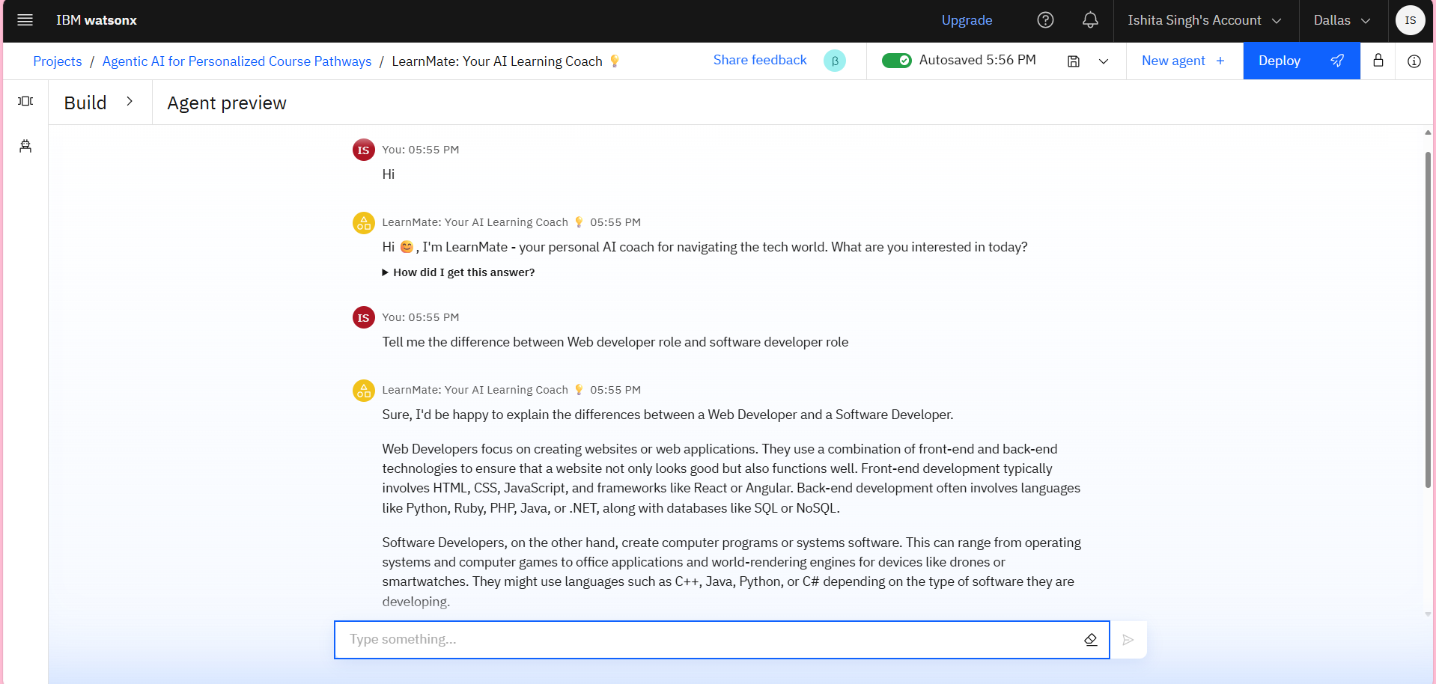
Results

Slide 10
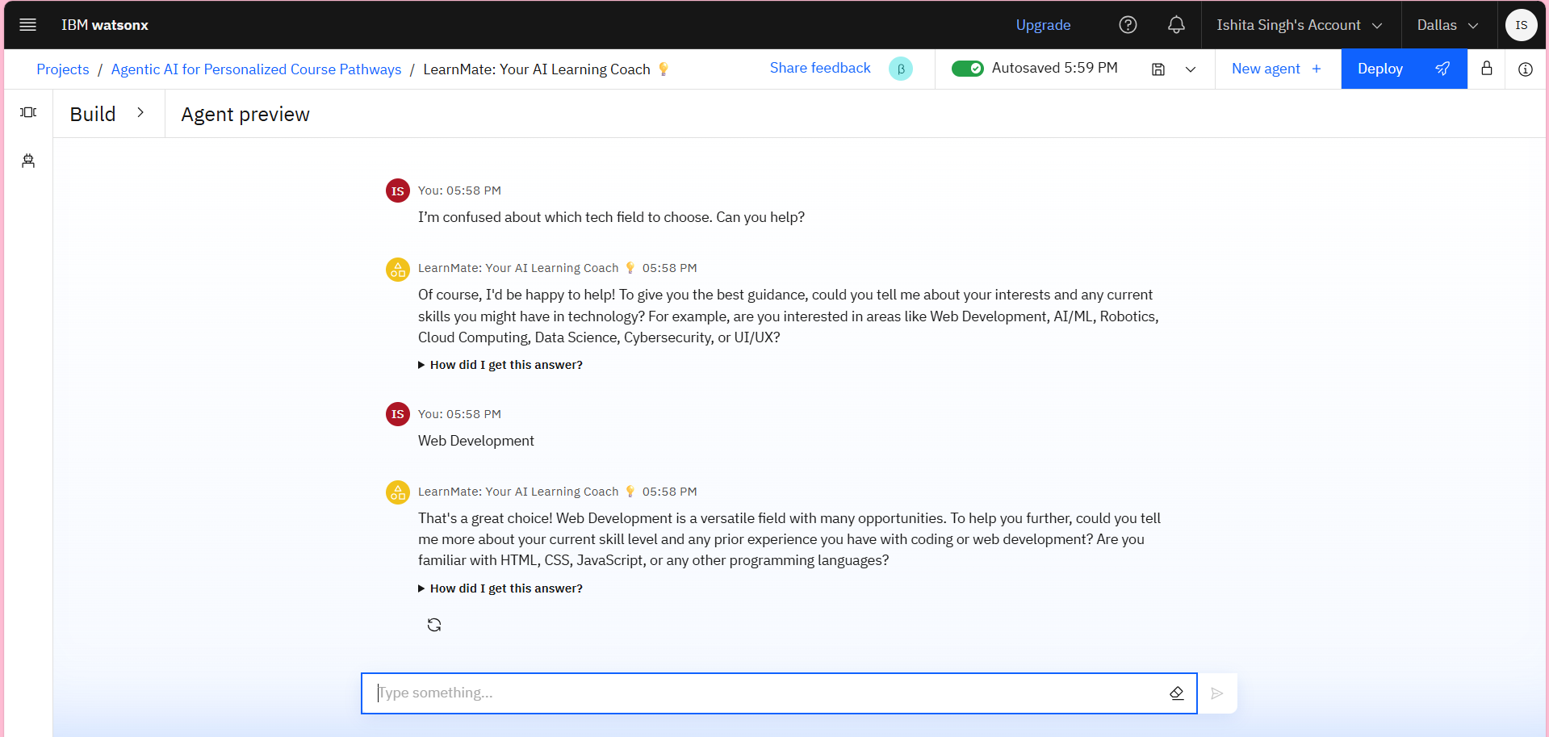
Results

Slide 11
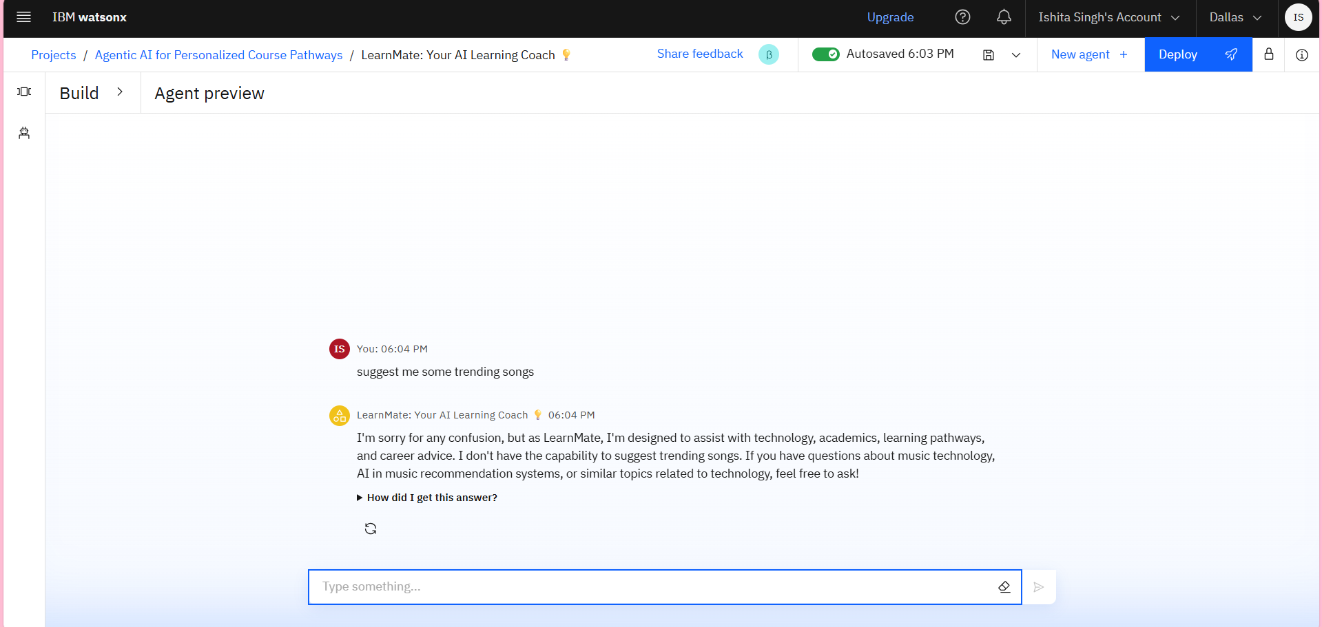
Results

Slide 12
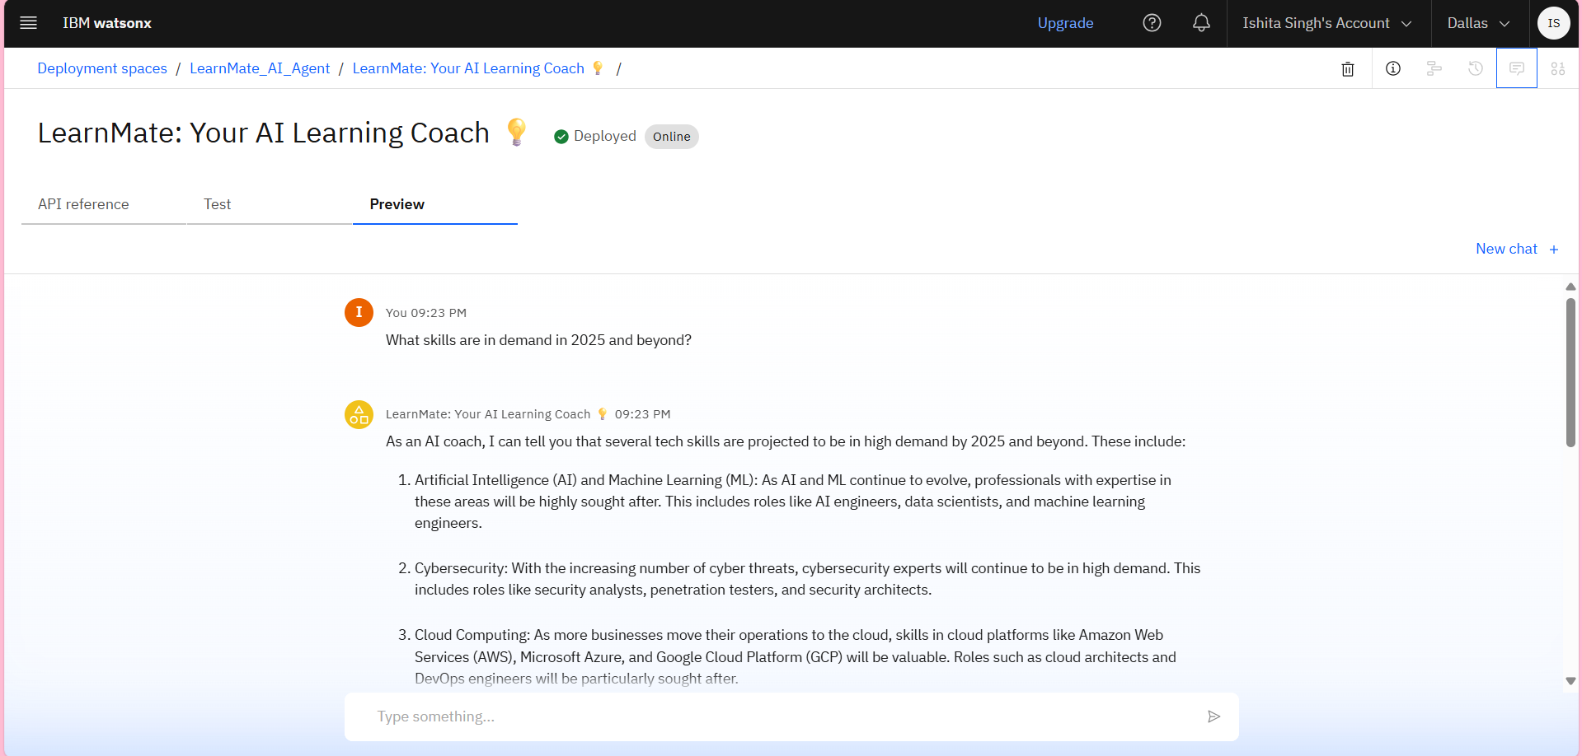
Results
Deployed AI Agent

Slide 13
Conclusion
LearnMate bridges the gap between confusion and clarity in a student’s tech journey. By combining conversational AI with adaptive learning paths, it acts as a personal career coach — guiding learners based on their interests, current skills, and goals.
This AI agent not only answers common student doubts but also empowers users to take the right steps with confidence by recommending the best resources, building roadmaps, and adapting to user progress.
It’s a step toward personalized, scalable, and student-centered learning with AI.

Slide 14
GitHub Link
Github link: https://github.com/InsaneIshita/LearnMate-Agentic-AI

Slide 15
Future scope
Multilingual Support: Expand accessibility by enabling the agent to understand and respond in multiple regional and international languages.
Website & UI Integration: Embed the AI agent into a user-friendly web interface for public access and real-time interaction.
Voice-Based Interaction: Enable voice input/output for hands-free, interactive guidance.
Institutional Adoption: Integrate with colleges or EdTech platforms to assist students with personalized tech learning paths.

Slide 16
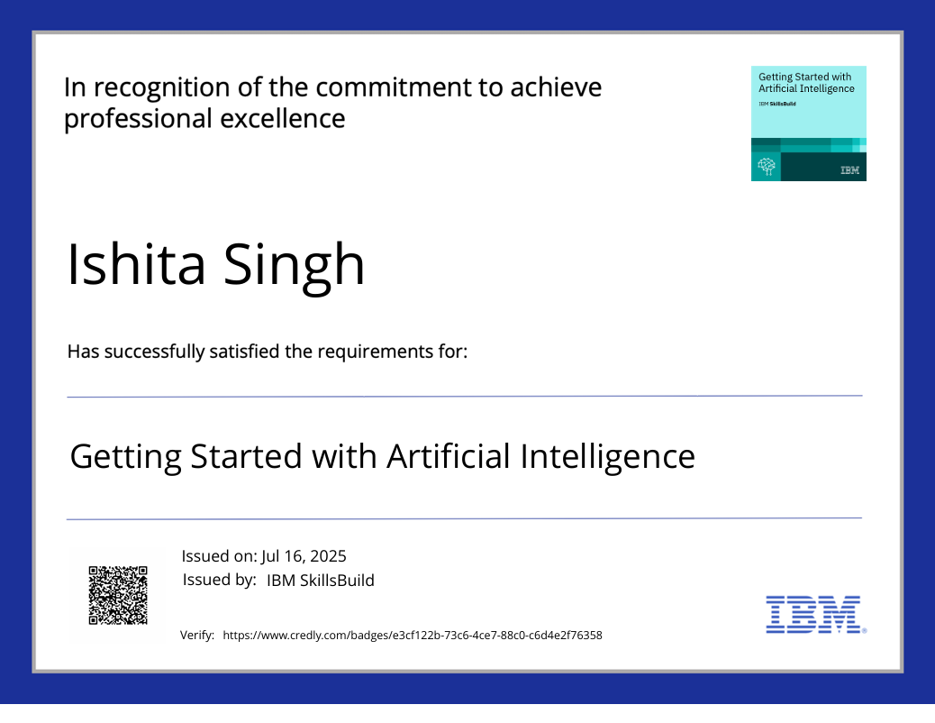
IBM Certifications

Slide 17
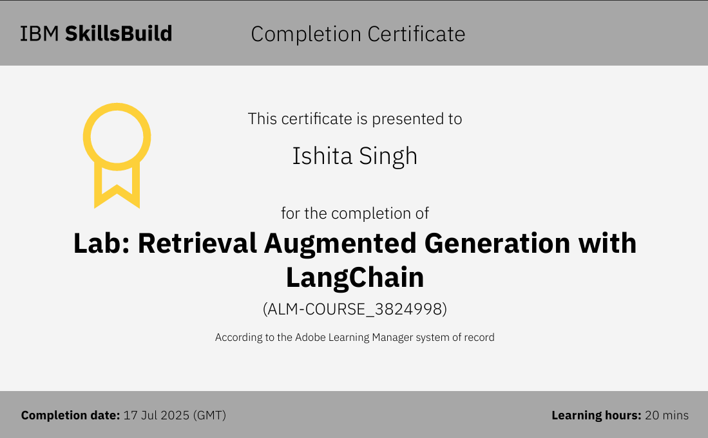

Slide 18
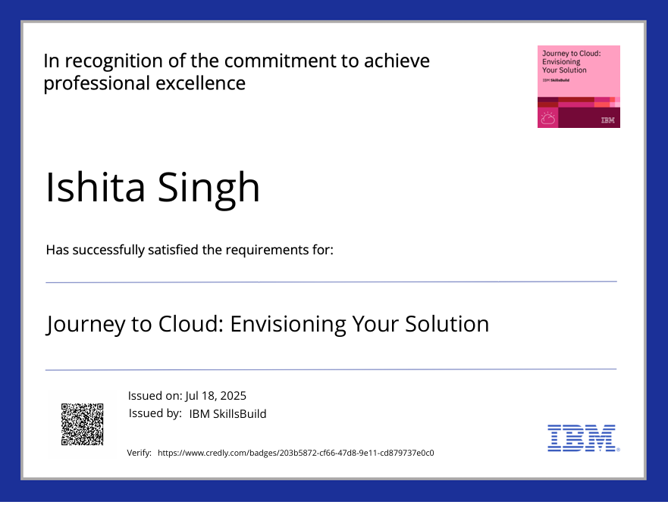

Slide 19
THANK YOU

